Slide 1
Linear Algebra
1427405017
沈家赟
2016.10

Slide 2
Scalars, Vectors, Matrices and Tensors
The study of linear algebra involves several types of mathematical object

Slide 3
Scalars
Definition:
A scalar is just a single number, in contrast to most of the other objects studied in linear algebra, which are usually arrays of multiple numbers.

Slide 4
Scalars
Usage:
We write scalars in italics.
We usually give scalars lower-case variable names. When we introduce them, we specify what kind of number they are.
For example, we might say “Let s∈R be the slope of the line,” while defining a real-valued scalar, or “Let n∈N be the number of units,” while defining a natural number scalar.

Slide 5
Vectors
Definition:
A vector is an array of numbers.

Slide 6

Vectors
Usage:
The elements of the vector are identified by writing its name in italic typeface, with a subscript.
The first element of x is x₁, the second element is x₂ and so on.
E.g.
$$x=\left[\begin{matrix}x_{1} \\ x_{2} \\ . \\ . \\ . \\ x_{n}\end{matrix}\right]$$

Slide 7
Matrices
Definition:
A matrix is a 2-D array of numbers, so each element is identified by two indices instead of just one.

Slide 8

Matrices
Usage:
We usually give matrices upper-case variable names with bold typeface, such as A.
If a real-valued matrix A has a height of m and a width of n, then we say that A∈ R_{m×n}
E.g.
$$\left[\begin{matrix}A_{1,1} & A_{1,2} \\ A_{2,1} & A_{2,2}\end{matrix}\right]$$

Slide 9
Tensors
Definition:
In the general case, an array of numbers arranged on a regular grid with a variable number of axes is known as a tensor.

Slide 10
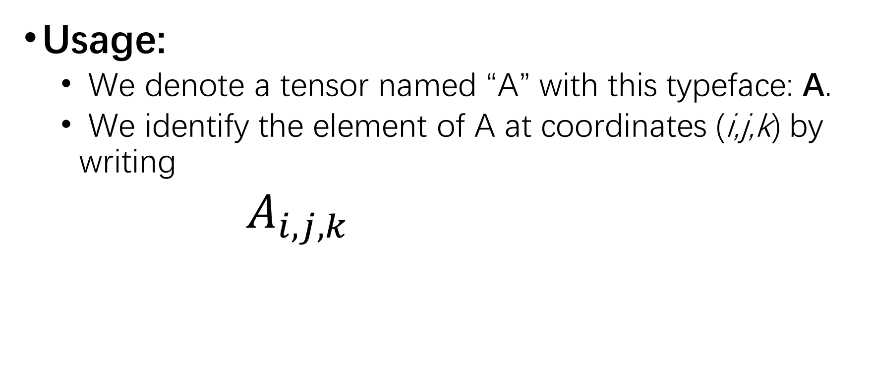
Tensors
Usage:
We denote a tensor named “A” with this typeface: A.
We identify the element of A at coordinates (i,j,k) by writing
$A_{i,j,k}$

Slide 11
Multiplying Matrices and Vectors
One of the most important operations involving matrices is multiplication of two matrices.

Slide 12
Multiplying
Definition:
The matrix product of matrices A and B is a third matrix C.

Slide 13
Multiplying
Usage:
In order for this product to be defined, A must have the same number of columns as B has rows.
If A is of shape m×n and B is of shape n×p, then C is of shape m×p.

Slide 14


Multiplying
E.g.
$$C=AB$$
$$ci,j=\sum_{k=1}^{n}{ai,kbk,j}$$

Slide 15
Multiplying
Features:
distributive: A(B + C) = AB + AC
associative: A(BC) = (AB)C
etc: (AB)^{T} = B^{T}A^{T}
Ax = b

Slide 16
...

Slide 17
End
Demo ends here.

